Slide 1
Retail Profitability Optimization: Global Superstore Case
Consulting Analysis Using Excel, SQL & Power BI
Presented by: Wrick Banerjee

Slide 2
Key Insights Driving Profitability Performance Across Categories and Regions
Technology is the most profitable category, contributing over 35% of total profit, driven by high margins and volume.
Furniture underperforms, with relatively low profit despite strong sales — discounting and shipping costs drive margin loss.
High-discount orders (≥30%) result in negative profit, especially in B2C segment; pricing strategy needs refinement.
Central and Western regions outperform others in profit margin; South and Africa show signs of margin pressure.
“Data Source: Global Superstore Dataset via GitHub – https://github.com/victorcezeh/global-superstore-project”

Slide 3
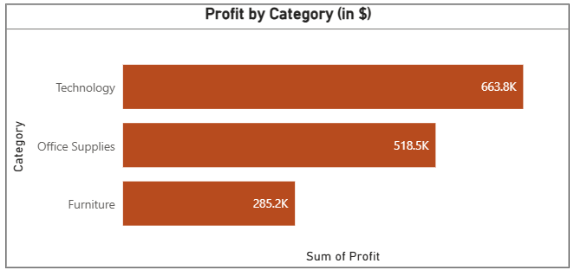
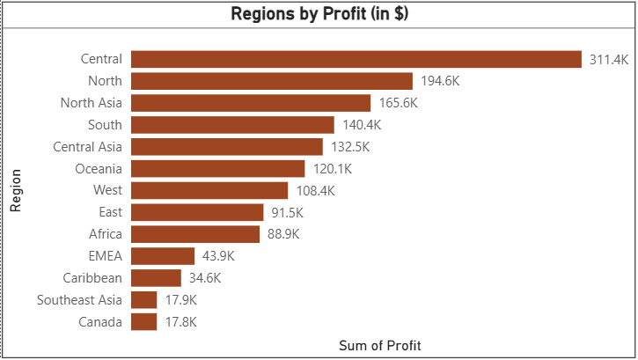
Category & Region-Level Profitability Breakdown
Technology leads in profit with over $145,000 — a clear margin leader
Furniture struggles, especially when deep discounts are applied
Central and Western regions drive most profits, while others show weak margin contribution
“Data Source: Global Superstore Dataset via GitHub – https://github.com/victorcezeh/global-superstore-project”

Slide 4
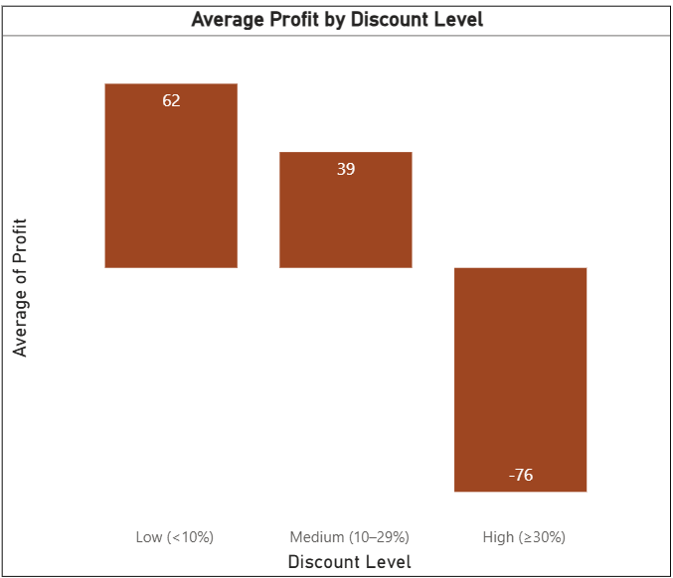
Orders with High Discounts (≥30%) Consistently Generate Losses
Orders with ≥30% discount result in average losses per sale
B2C and Furniture segments are especially vulnerable
Strategic discounting is needed to protect margins
“Data Source: Global Superstore Dataset via GitHub – https://github.com/victorcezeh/global-superstore-project”

Slide 5
Strategic Actions to Improve Profitability and Pricing Efficiency
3 Key Recommendations:
Rationalize Discounting Strategy
Cap discounts at 20% in low-margin categories (e.g., Furniture)
Prioritize value-based pricing for B2C orders
Double Down on High-Margin Segments
Expand marketing and fulfillment for Technology and Office Supplies
Focus on Central and West regions for growth
Investigate Operational Inefficiencies
Deep dive into product lines with negative margins
Reassess shipping methods and costs for loss-making orders
“Data Source: Global Superstore Dataset via GitHub – https://github.com/victorcezeh/global-superstore-project”

